Slide 1
Eutrophication

Slide 2
Paper Setup
Date ________ pg. ___
Eutrophication
Notes:
My Definition:
Video

Slide 3
Class Definition – 1st Core
Eutrophication is a process that happens when water has too many nutrients from fertilizer runoff into water creating algal blooms causing a lack of sunlight to reach the bottom of the water; bacteria will grow and use up most of the oxygen and other organisms will die.

Slide 4
Class Definition – 2nd Core
Eutrophication is a process when nitrate and phosphate are washed into a river and these nutrients produce rapid algae growth which causes an algal bloom which can reduce sunlight for plants below the surface of the water; plants will die and bacteria will consume the decaying organisms using up most of the oxygen in the water causing other organisms in the water to die.

Slide 5
Class Definition – 3rd Core
Eutrophication occurs when fertilizers leak into the water and add too many nutrients into the water, this causes algae to grow and may block sunlight from plants below the water’s surface; plants will die and be eaten by bacteria which use up most of the dissolved oxygen causing all other organisms to die.

Slide 6
Class Definition – 4th Core
Eutrophication is when too many nutrients are added to lakes and streams causing algae to be created and eat up most of the nutrients; this algae floats to the top of the water blocking out the sun from plants below the surface; plants will die and be eaten by bacteria which use up the oxygen in the water (becoming anoxic) all other organisms will die.

Slide 7
Formal Science Definition
Eutrophication is the excess buildup of nutrients (frequently due to runoff from land) in a body of water which causes rapid growth of plant life and death of animal life from lack of oxygen.

Slide 8
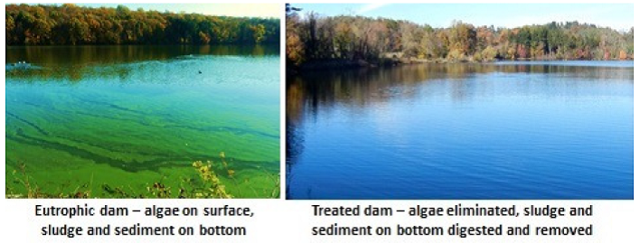

Slide 9
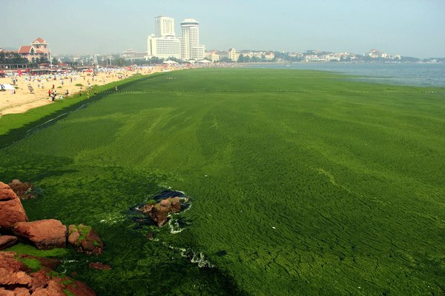

Slide 10
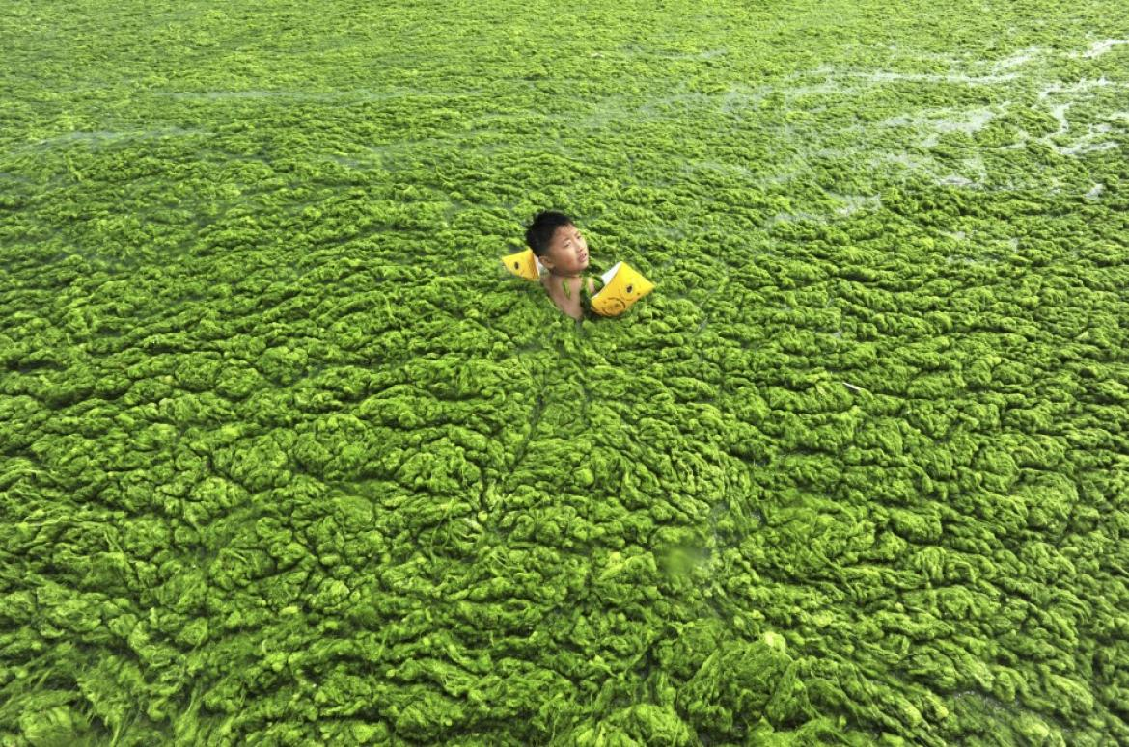

Slide 11
Steps in the eutrophication process
Place these steps in the correct order:
____ algae die and are decomposed by bacteria
____ nutrients promote plant growth of phytoplankton, especially algae
____ excessive nutrients (like nitrate and phosphate) from fertilizers, sewage,
detergents, etc. are carried by runoff from the land into rivers or lakes
____ an algal bloom occurs and may prevent sunlight from reaching other
plants below the water’s surface
____ fish, macroinvertebrates, and other aquatic life forms die
____ there is a decrease in dissolved oxygen levels due to an overabundance
of bacteria
4
2
1
3
6
5

Slide 12
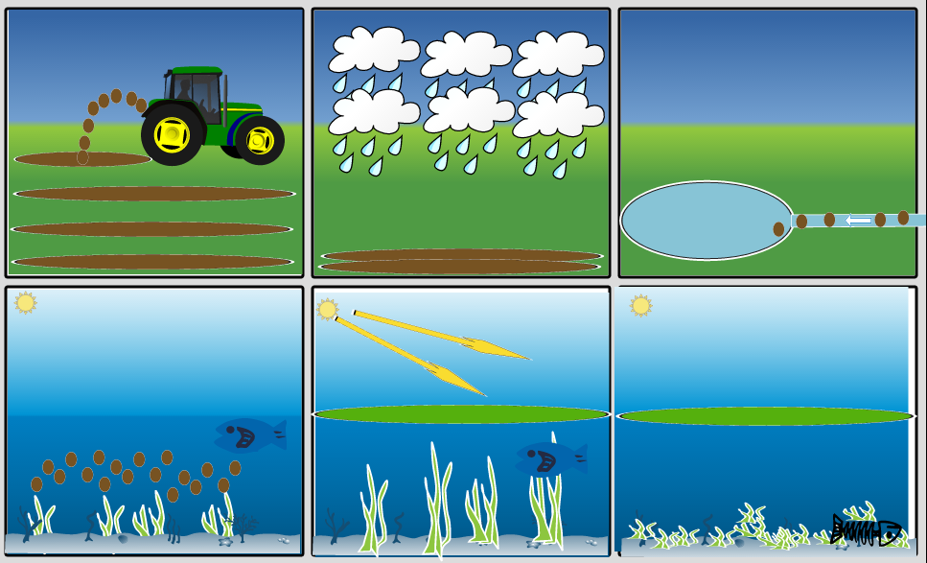

Slide 13
